Slide 1
ECEN 404:
Active Ankle-
Foot Orthosis (AAFO)
Alfred Boss
Christopher Galik
Tyler Pierce

Slide 2
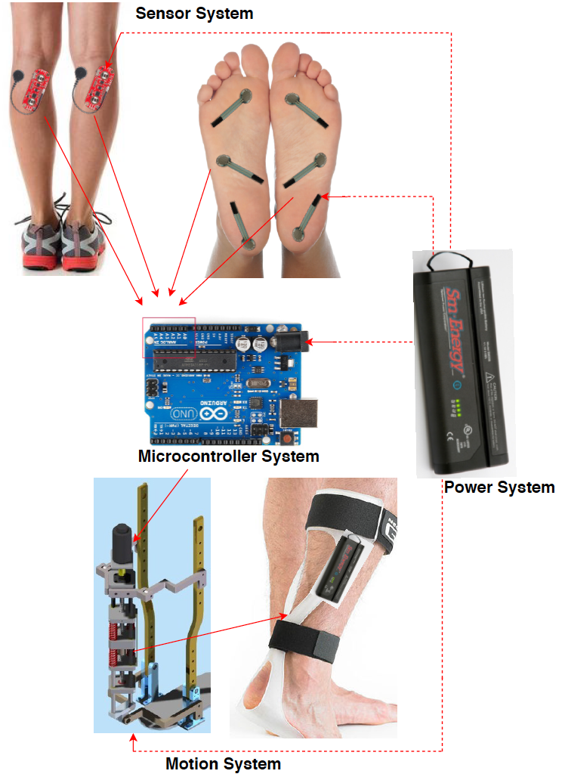
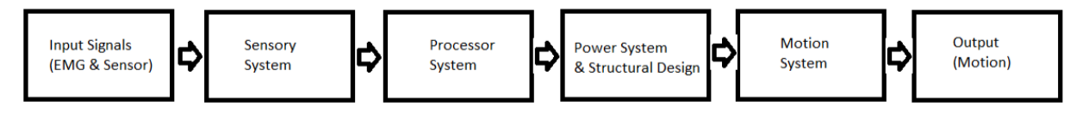
System Overview
EMG sensors and FSR sensors will measure electrical activity and pressure in the leg and foot.
The AAFO will transport signals from the 2 sensors to the MCU.
The microcontroller will interpret signals and determine which stage of gait the user is in and supply corresponding motor control.
The motion system, which acts as an artificial muscle, will move the joint by attaching to a rigid structure.

Slide 3
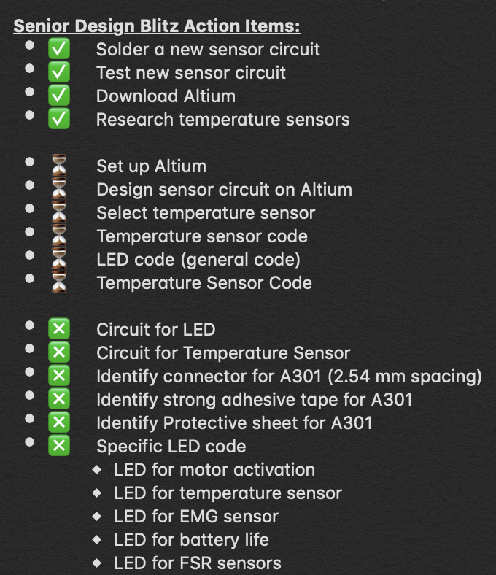
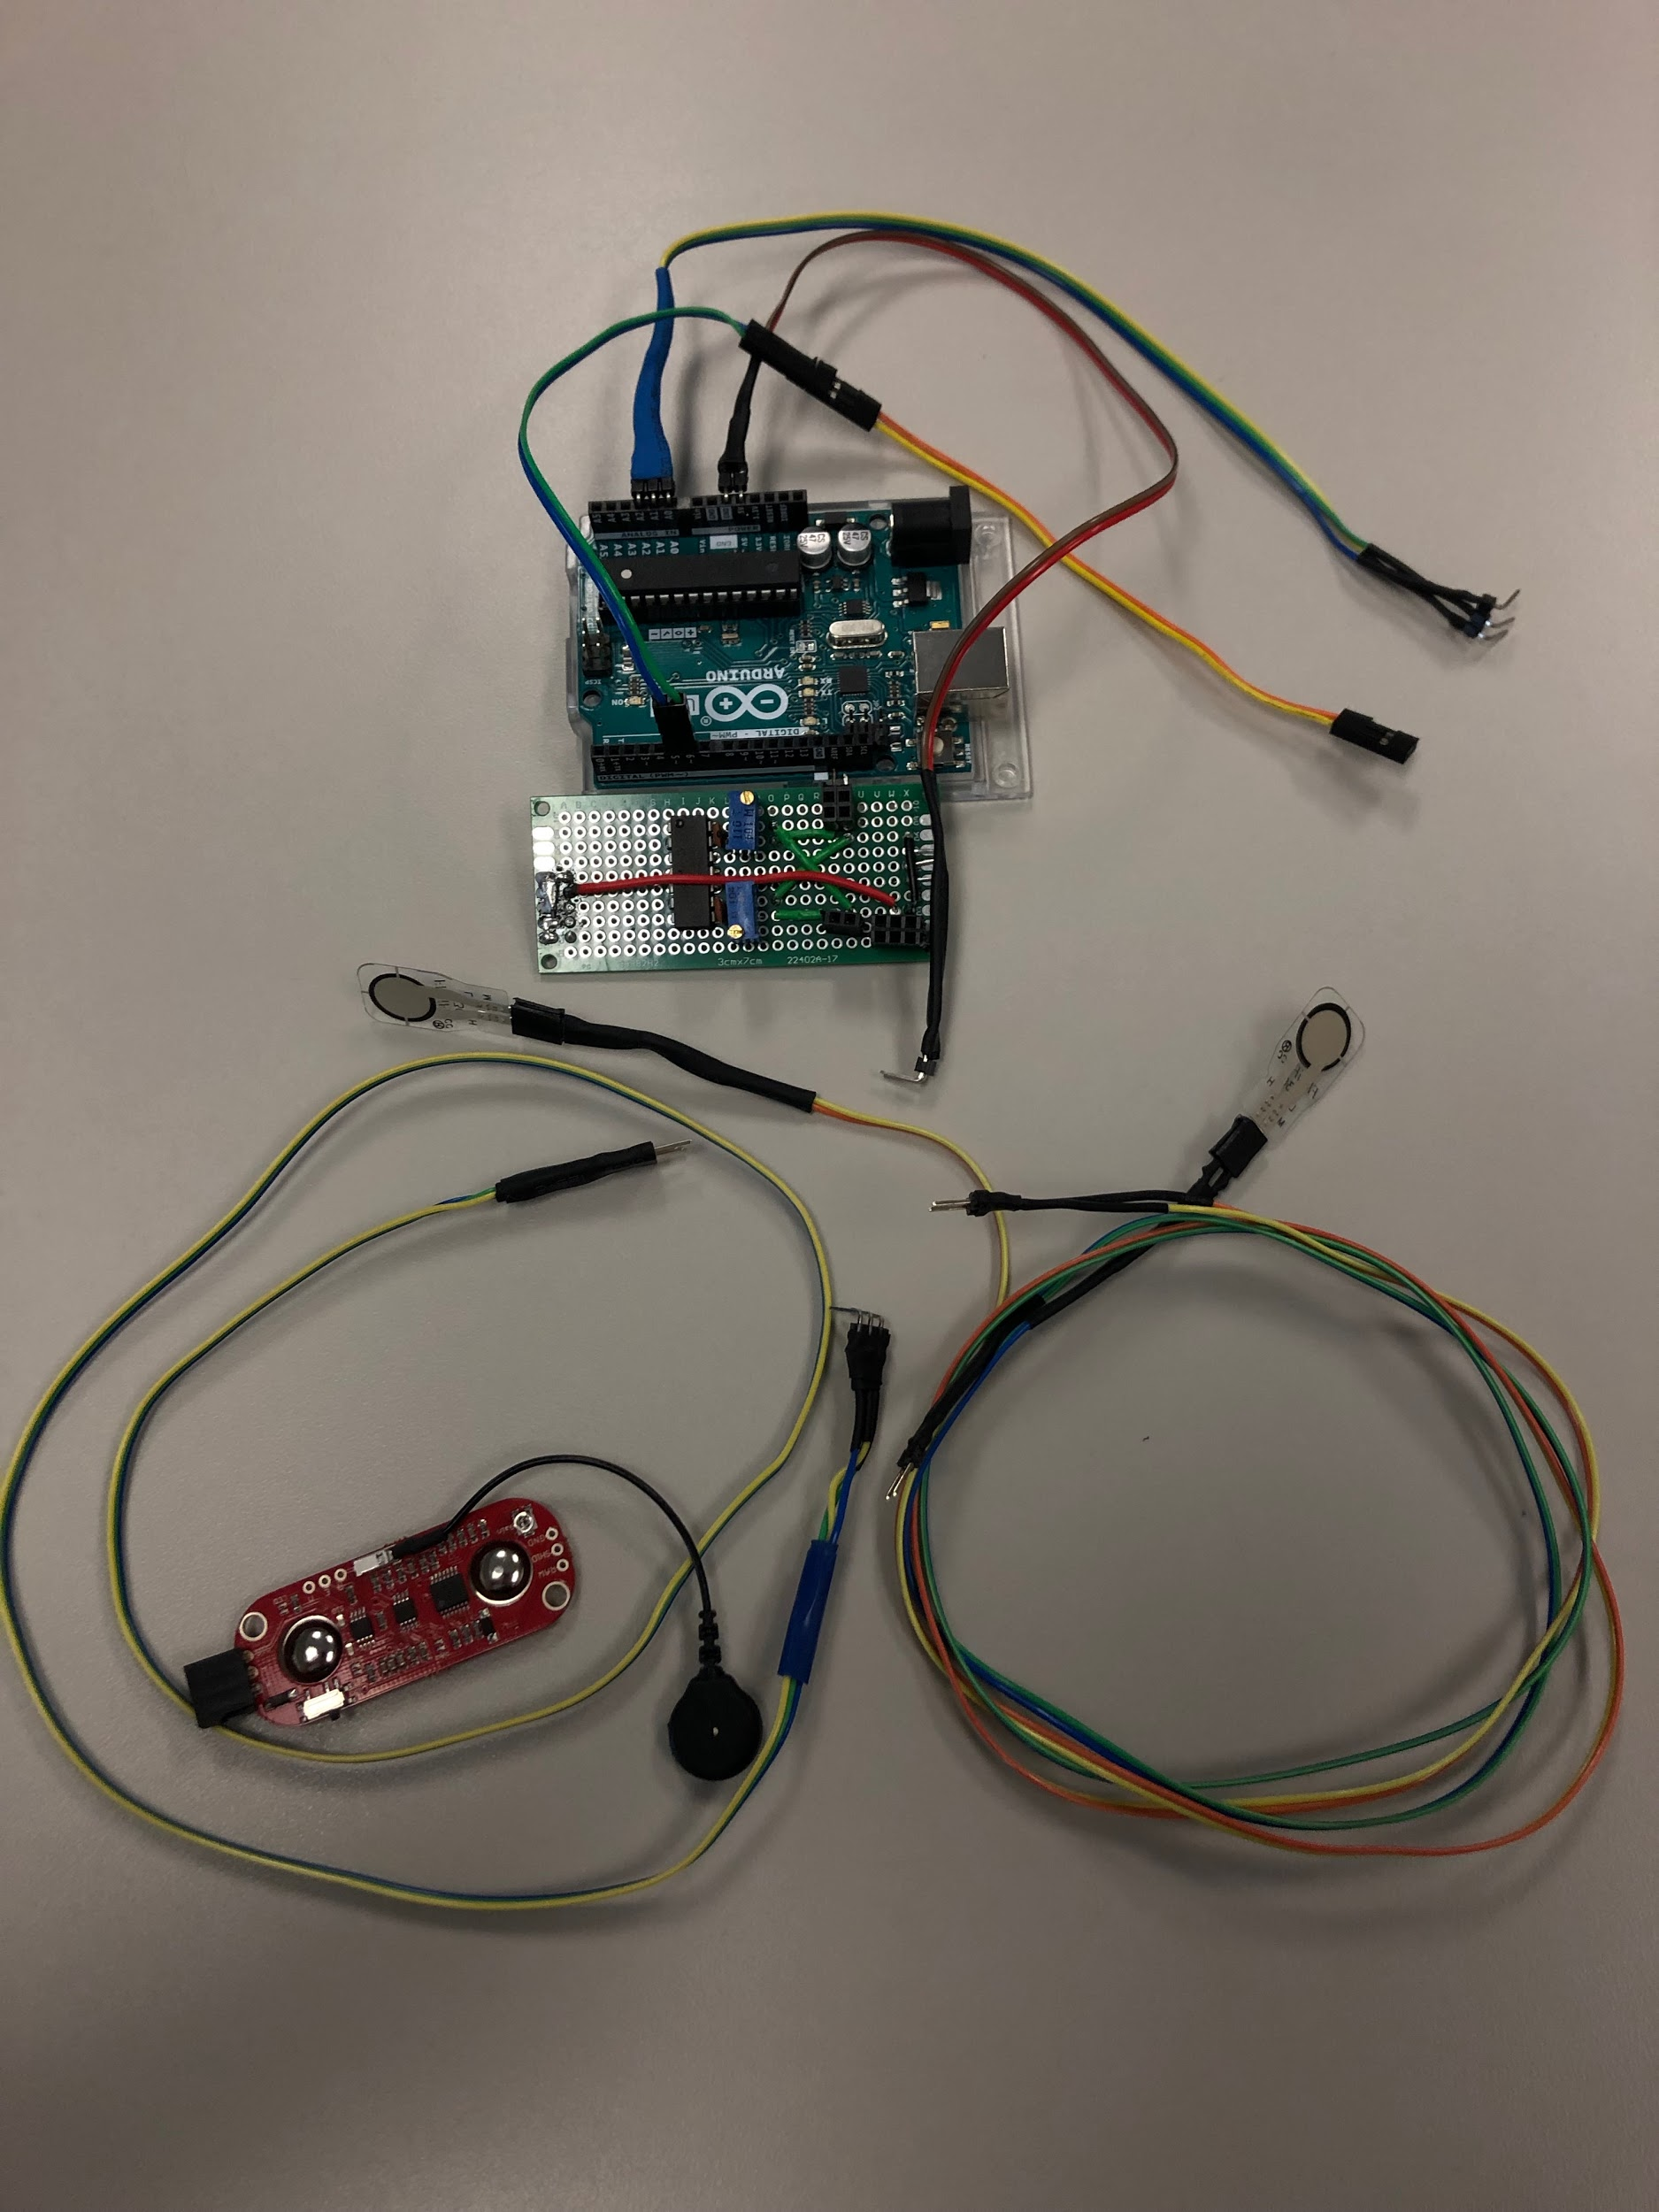
Sensor & MicroController System

Slide 4
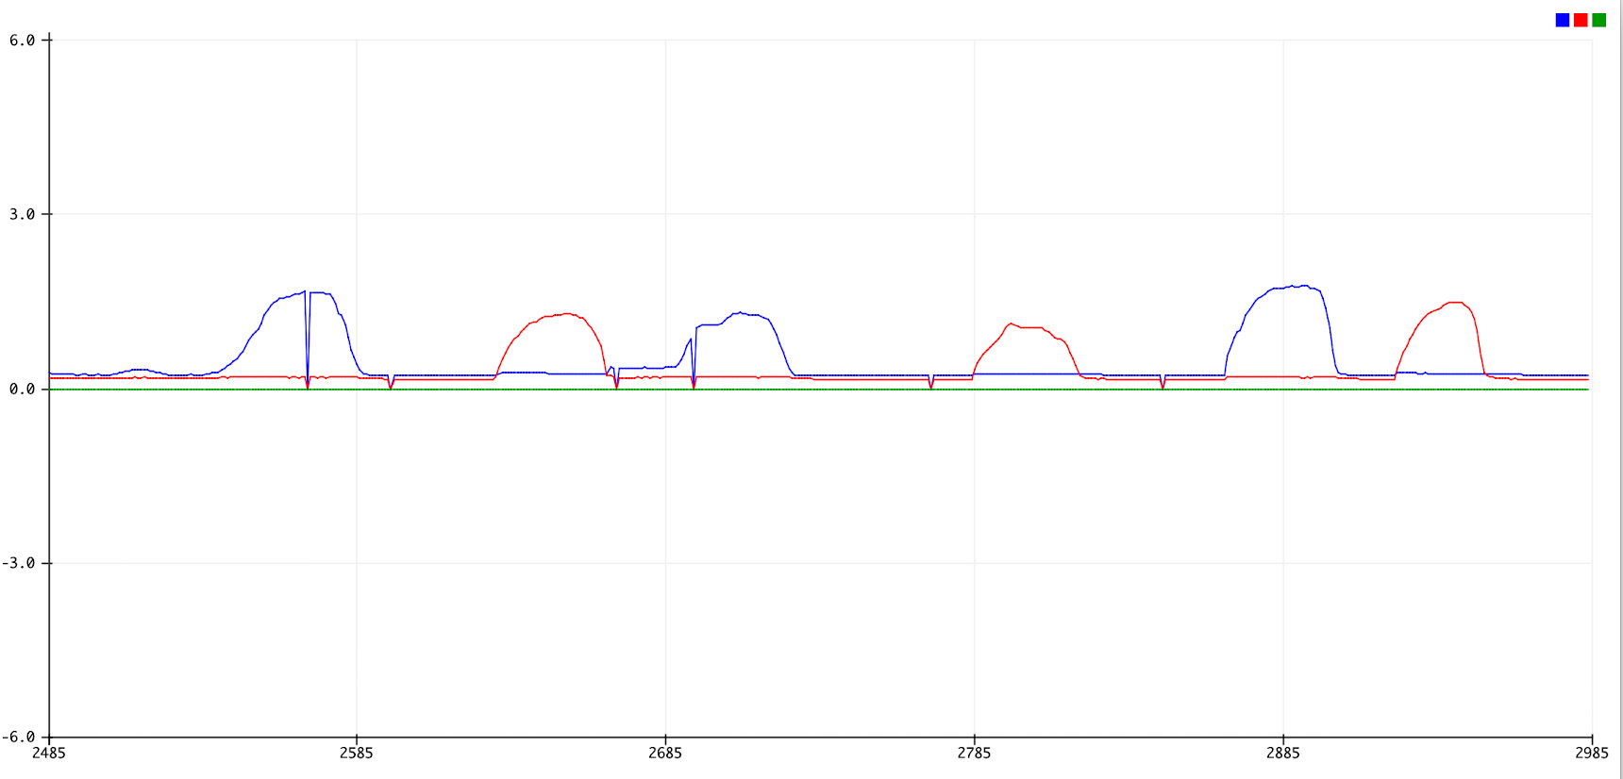
New sensor circuit output

Slide 5
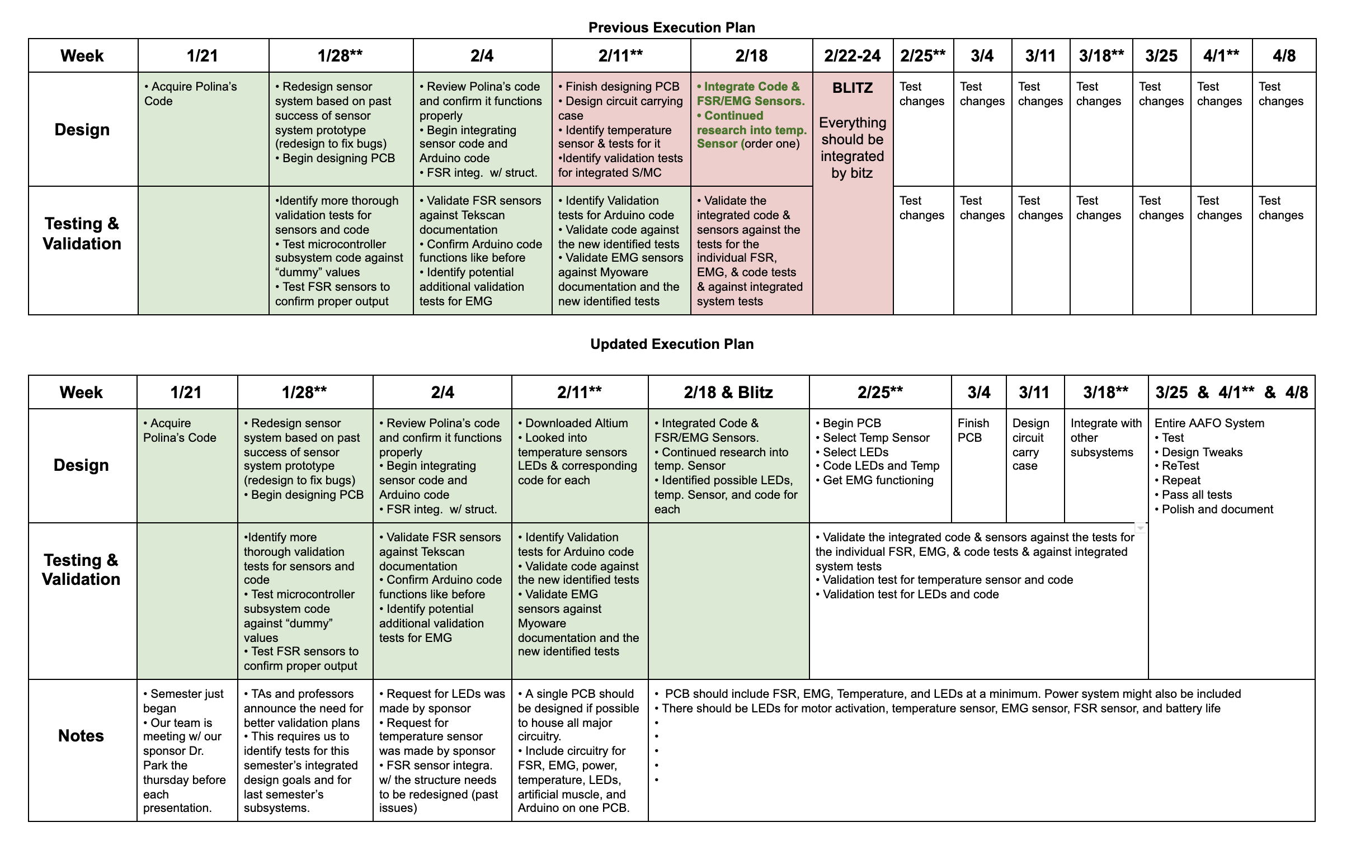
Sensor & MicroController Updated Timeline

Slide 6
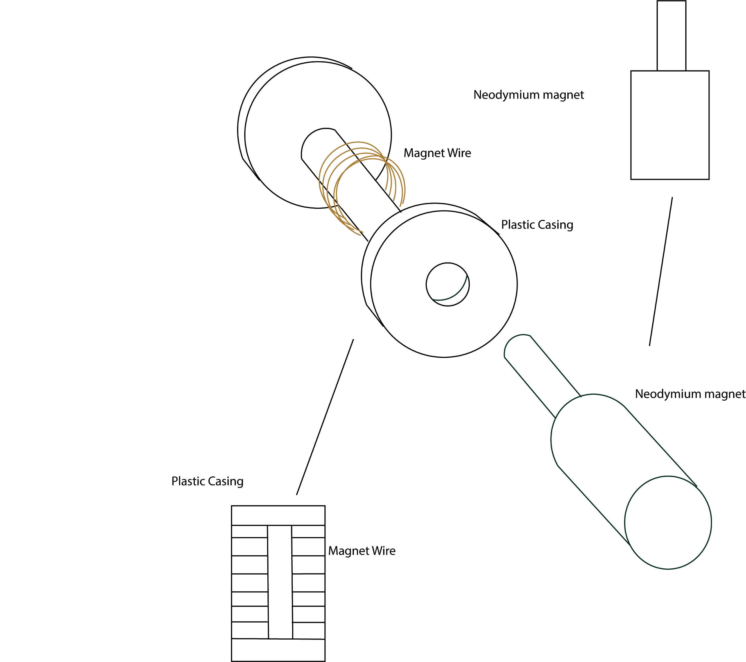
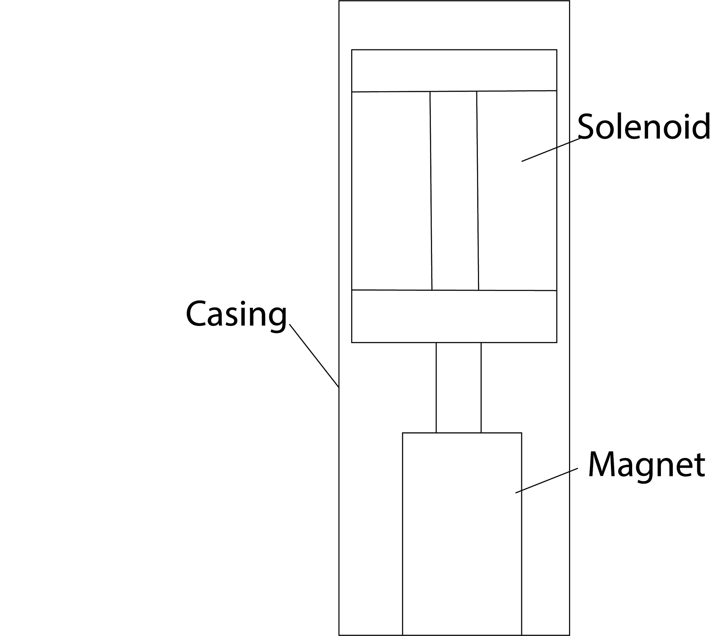
Artificial Muscle/Motion System Development
Bi-Weekly Accomplishments
3D print for structure integration (re) Initiated
Ongoing progress/problems
Major 3D printing errors
Delays
Final Validation for A.M. in and out of structure system with newtonmeter

Slide 7
Structural Design
Bi-Weekly Accomplishments
Solidworks stress validation - license acquired
Ongoing progress/problems
Integrate structure with Artificial Muscle and test

Slide 8
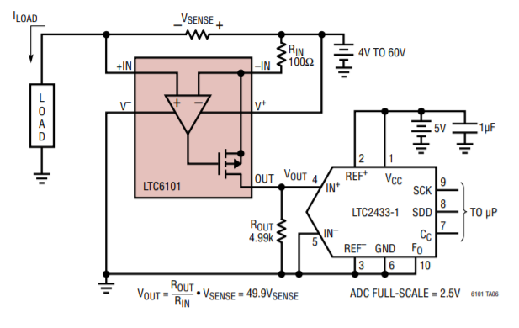
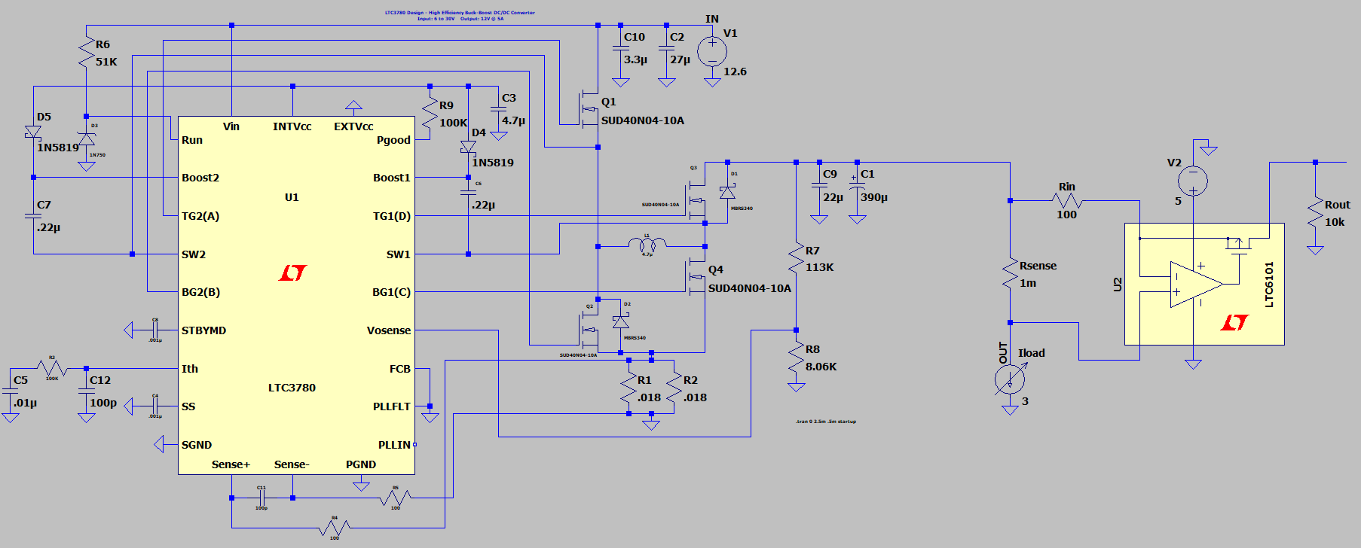
Power System
Bi-Weekly Accomplishments
Ordered Pre-built CC/CV converter
Simulating LTC circuit - DC-DC Converter Completed
Ongoing progress/problems
Simulation - CSR & OpAmp
Operational validation
Notes:
10 pins power req for MC, 0.7A for max current needed for AM, 0.65 minimum, switch solution for speed control

Slide 9
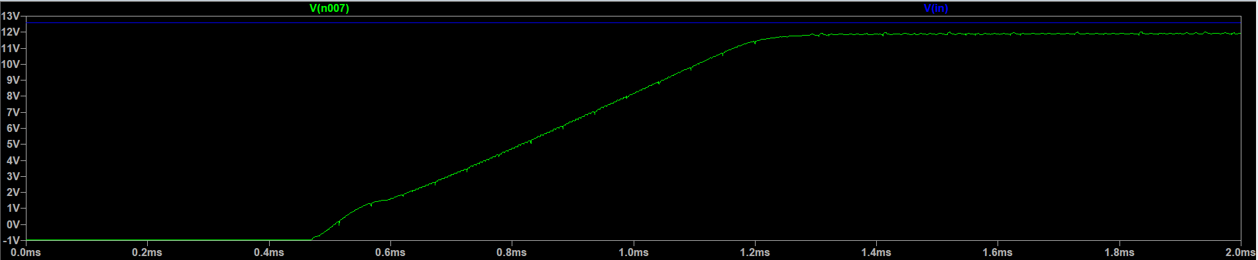
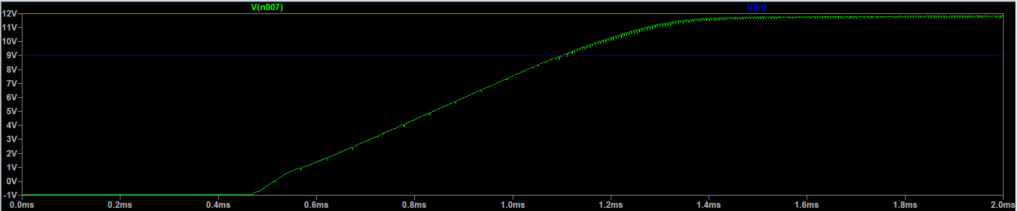
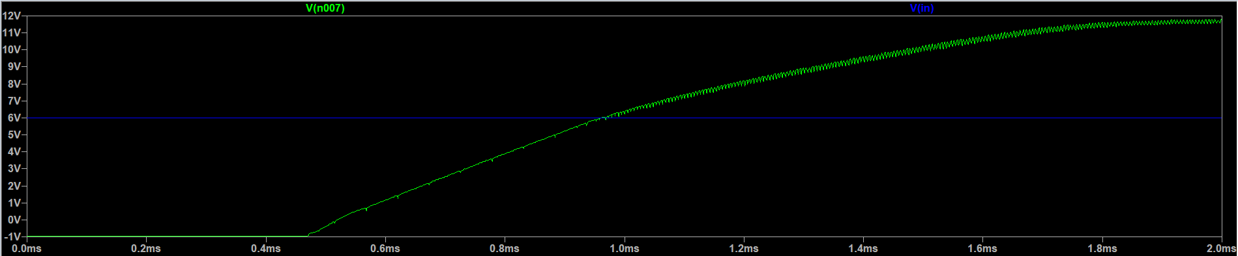
LTSpice Simulation - DC-DC Converter
12.6V
9V
6V

Slide 10
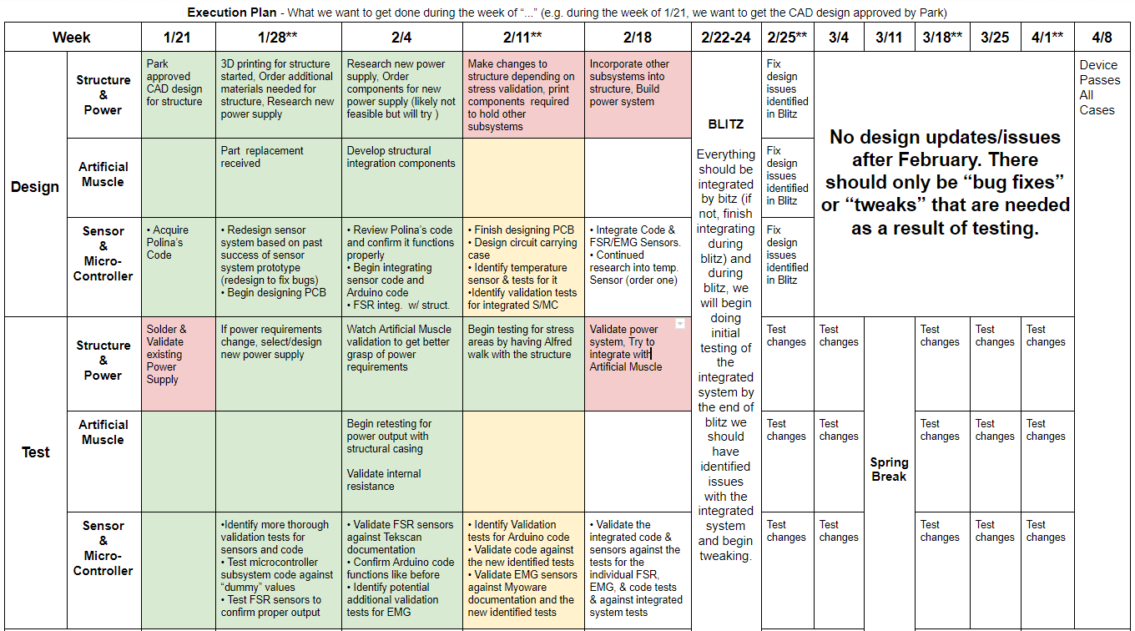
Execution Plan

Slide 11
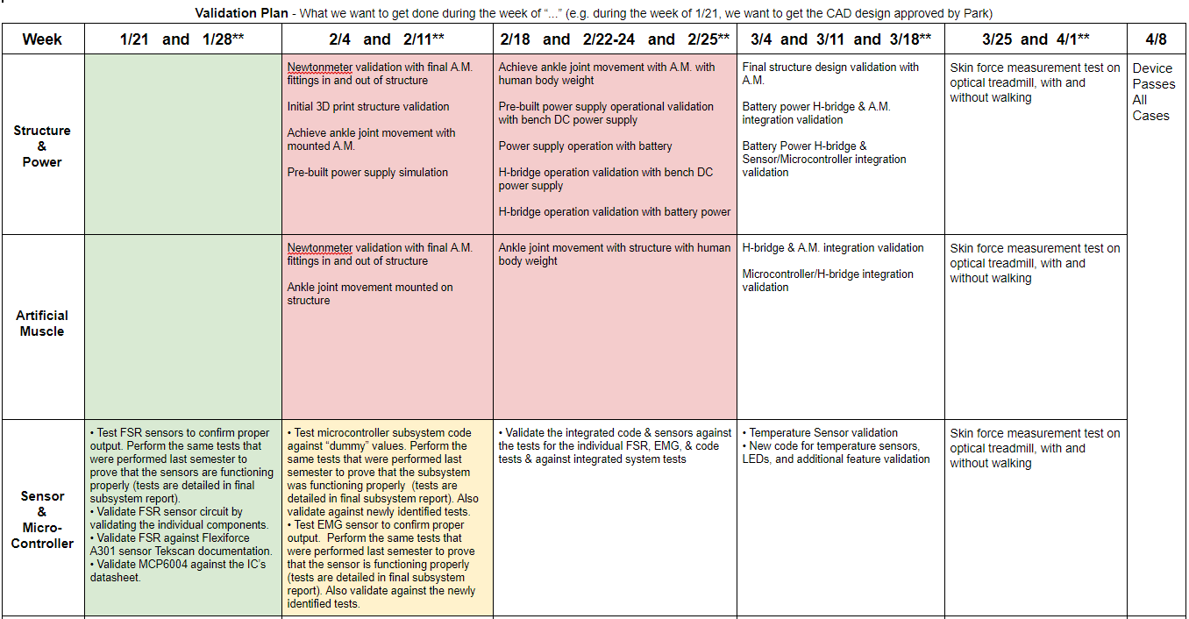
Validation Plan

